Slide 1
Quarterly Partner Meeting
Thursday, August 18, 2022

Slide 2

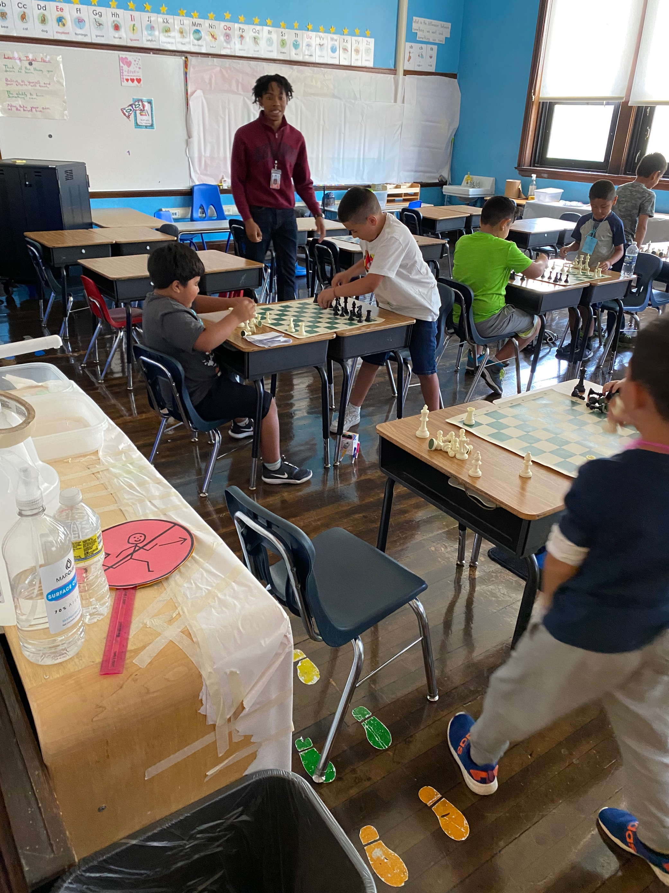
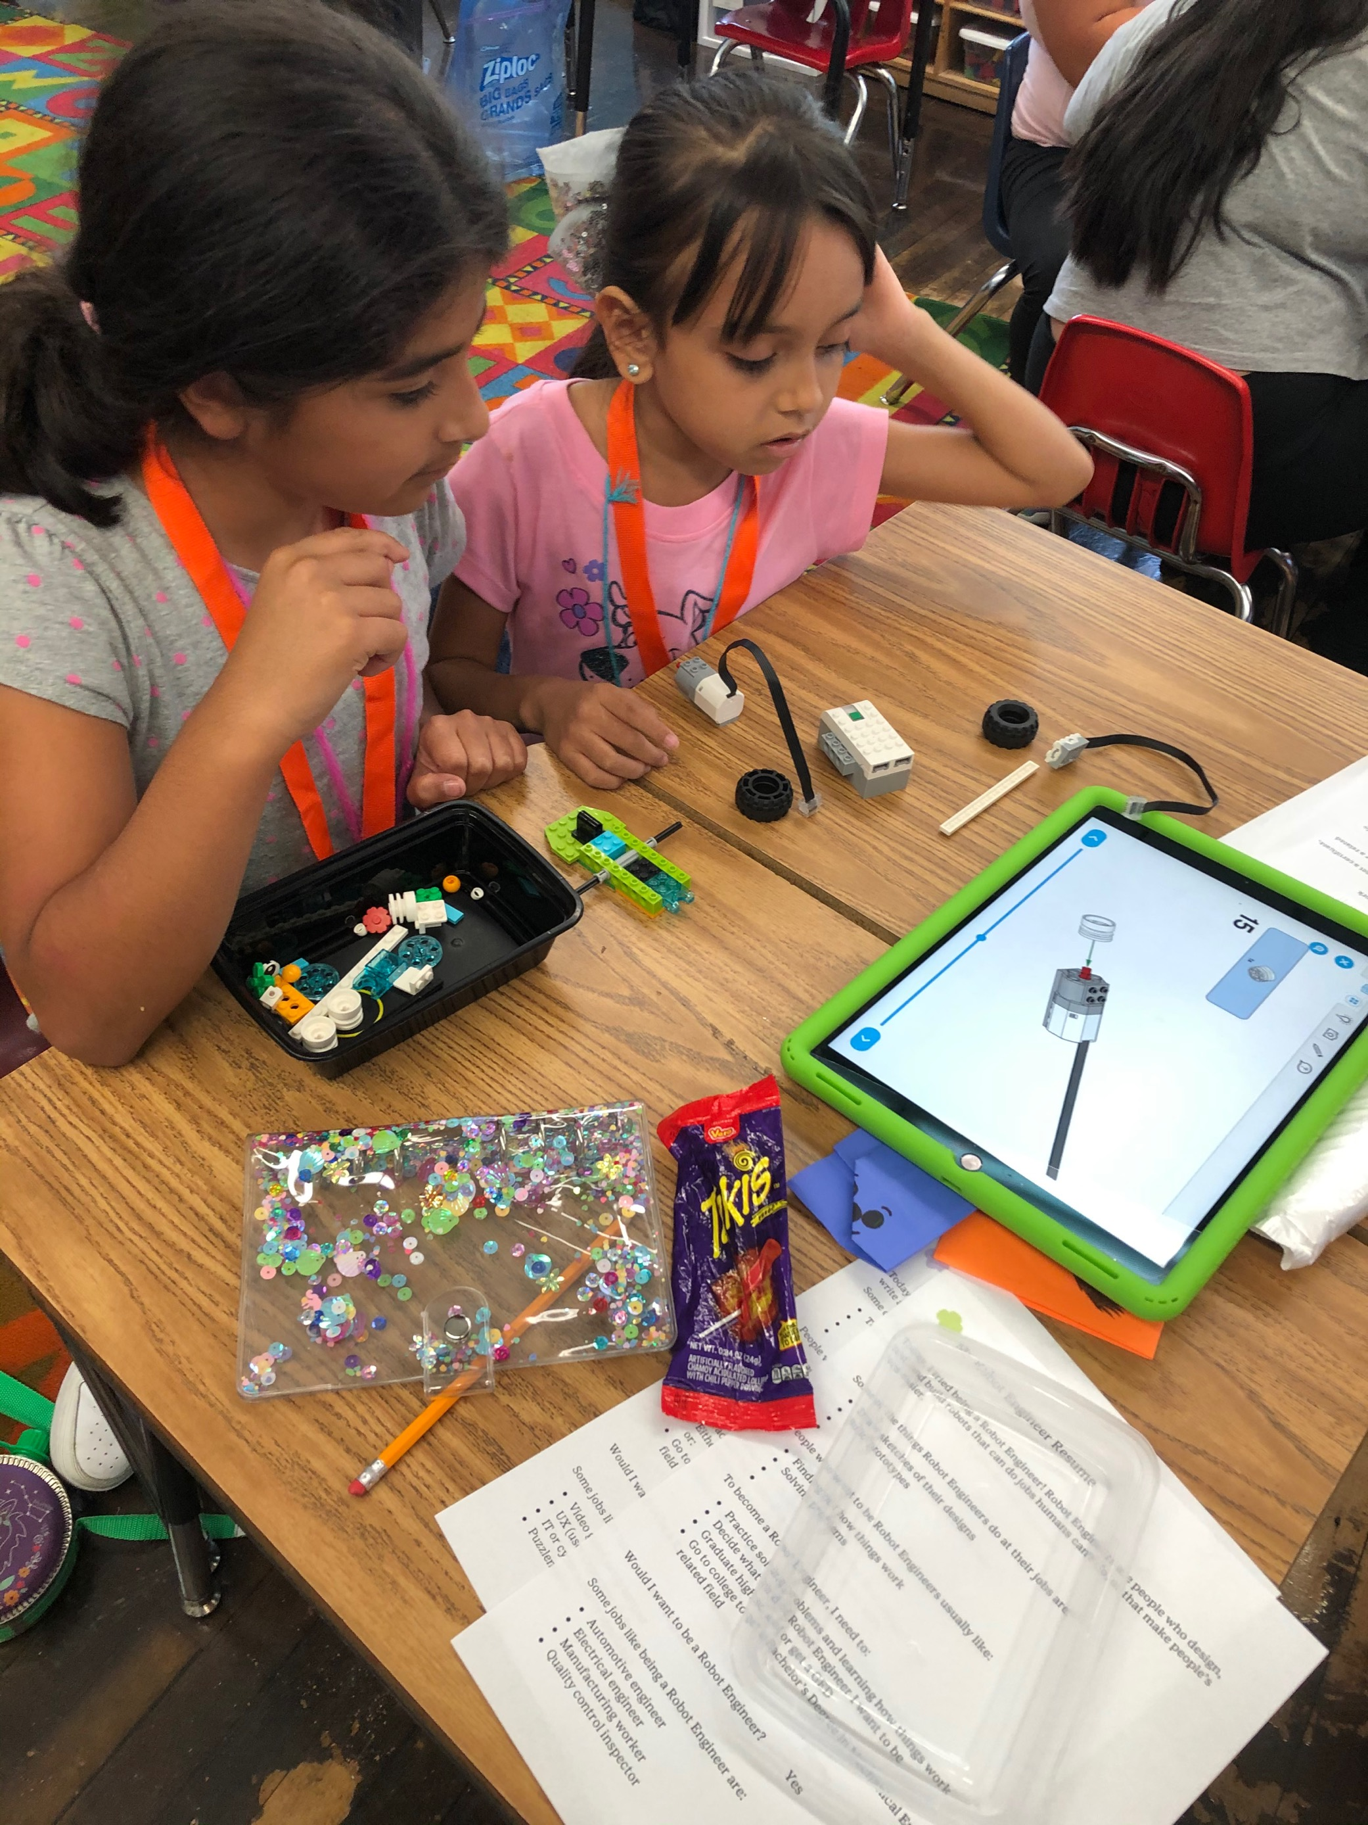
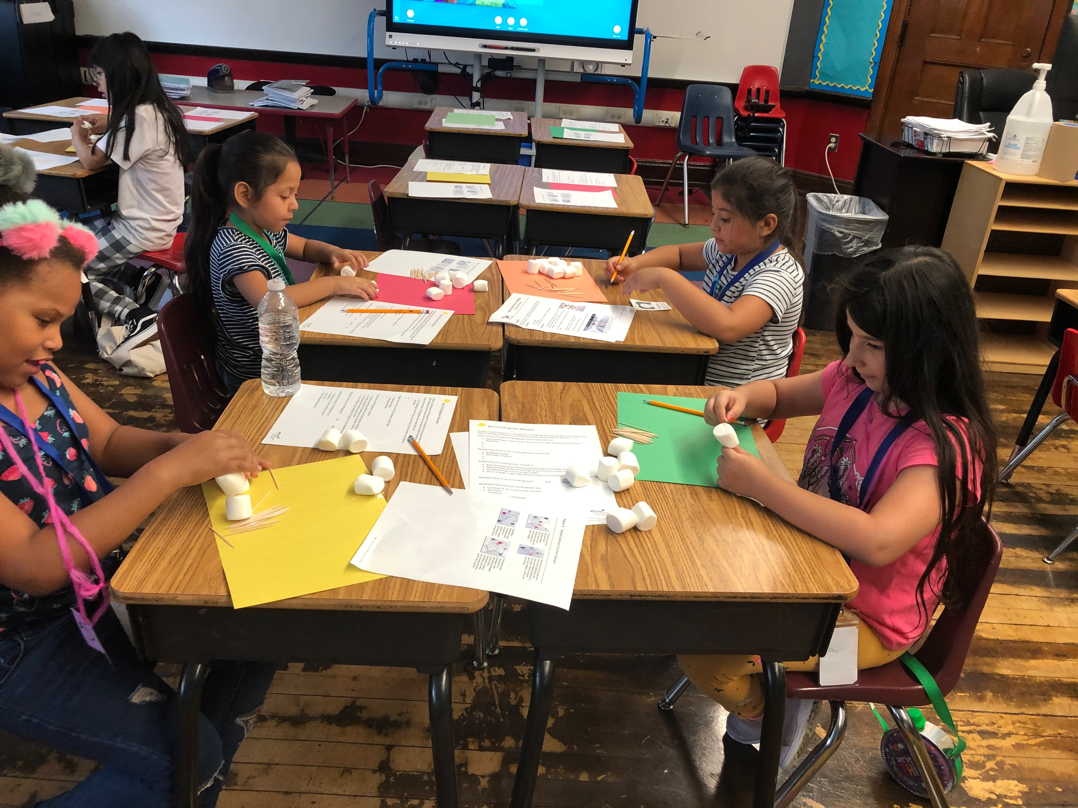

Slide 3
Agenda
Welcome
DPSCD 22-23: Year of Coherence
What does coherence mean for partners?
Resources, Announcements, & Reminders
Questions & Feedback

Slide 4
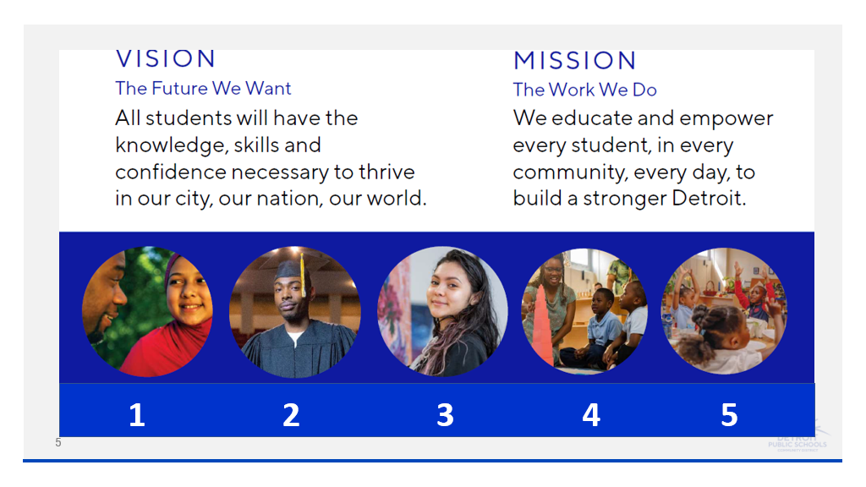

Slide 5
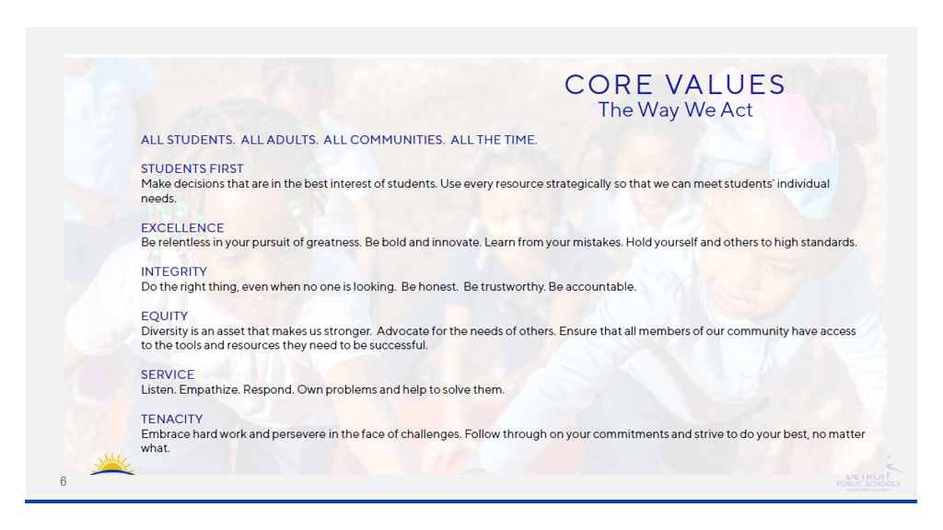

Slide 6
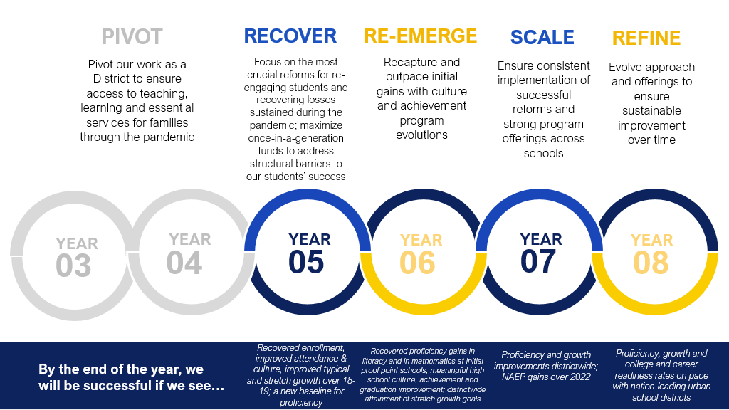

Slide 7
The Importance of Coherence
co·her·ence
noun
the quality of being logical and consistent
the quality of forming a unified whole

Slide 8


co·her·ence

Slide 9
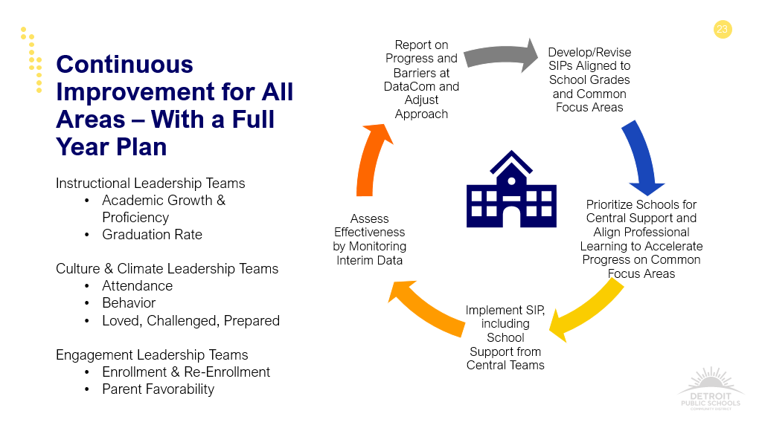
Each school has a goal of increasing their school grade by a full 10% by implementing common SIP strategies across the District, and coherent support & Professional Learning

Slide 10
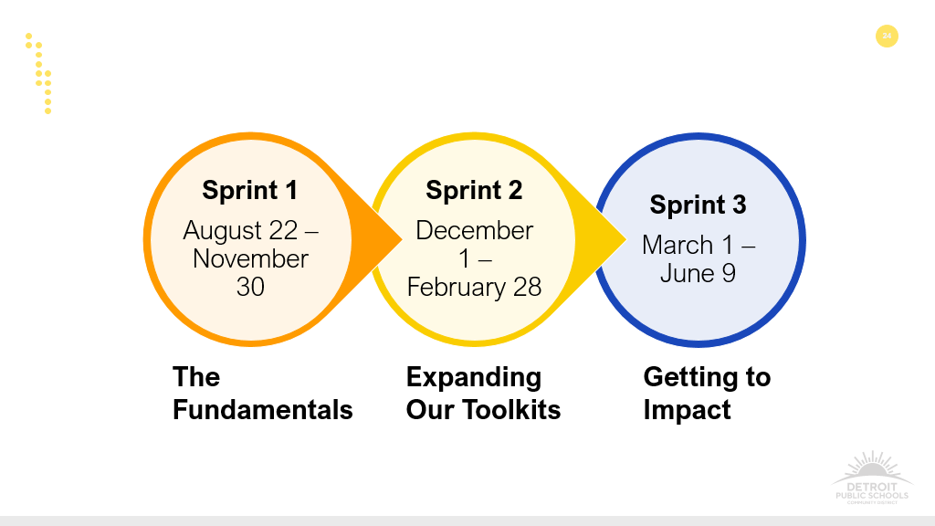
Sprints

Slide 11
What does coherence mean for partners?
Alignment with mission, vision, and values
Strategic integration with and support for other student experiences
Communication with central office endorser, not just individual principals
Collaboration to address chronic absenteeism

Slide 12
Announcements & Reminders
The Partnerships Office has virtual office hours every month. Come join us on August 24th from 12:00-12:30.
The Board’s most current COVID-19 guidance does not require partners to test weekly or file a specific plan for face-to-face engagement. Masks are optional in DPSCD facilities.
School starts on August 29th!
Students and teachers are off from September 2nd-5th.

Slide 13
Resources
Visit our website.
Use our automated inquiry system to get immediate answers and support.
Check out the Community Partner Map.

Slide 14
Got questions, comments, concerns, or feedback? You have options!
Drop your name, email address, and inquiry in the chat right now.
Try asking our automated inquiry system.
Email us.

